Slide 1
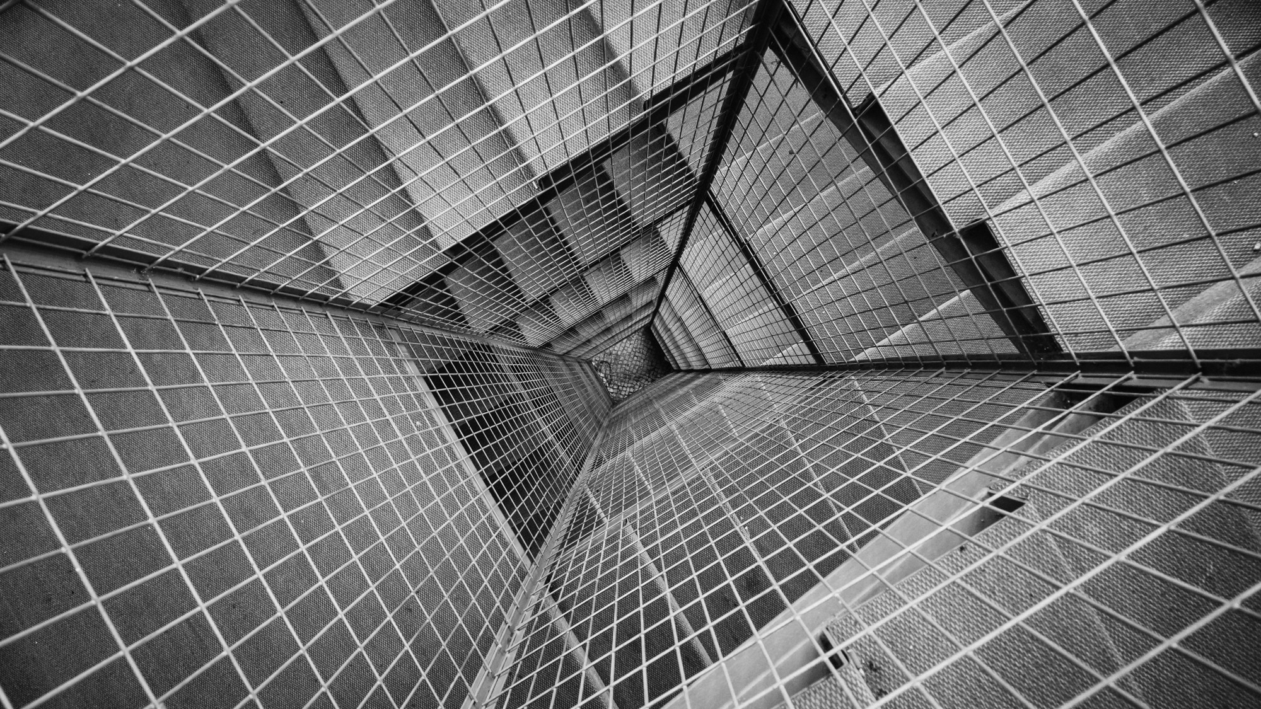
CLAIM MANAGEMENT
TEAM SUPERCRISPY
ON THE BLOCKCHAIN

Slide 2
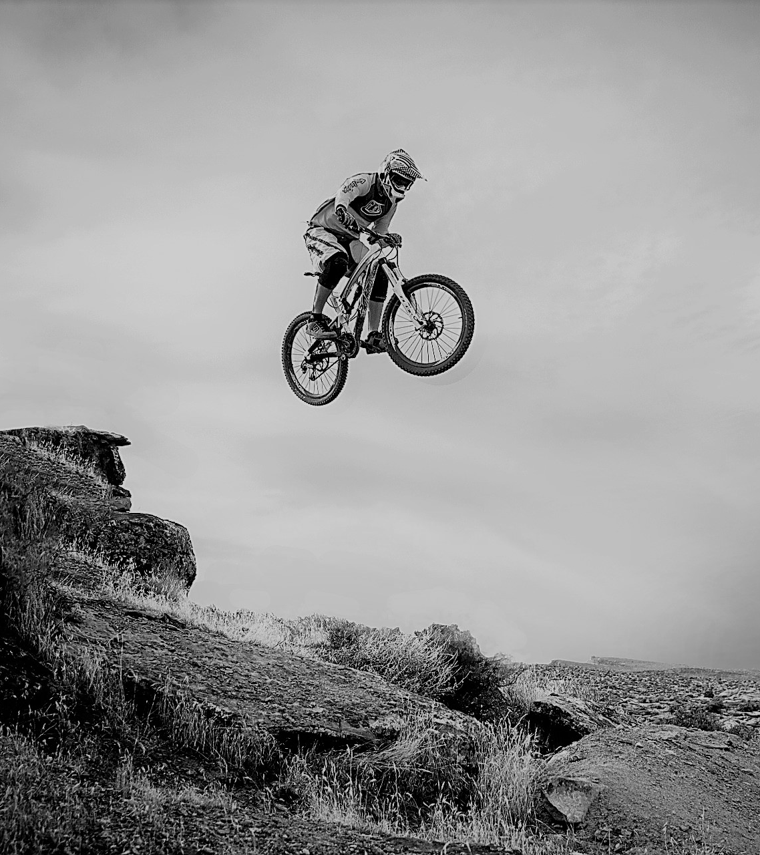

REBECCA IS ALMOST THERE...

Slide 3

OH NOOO! SHE CRASHES.

Slide 4
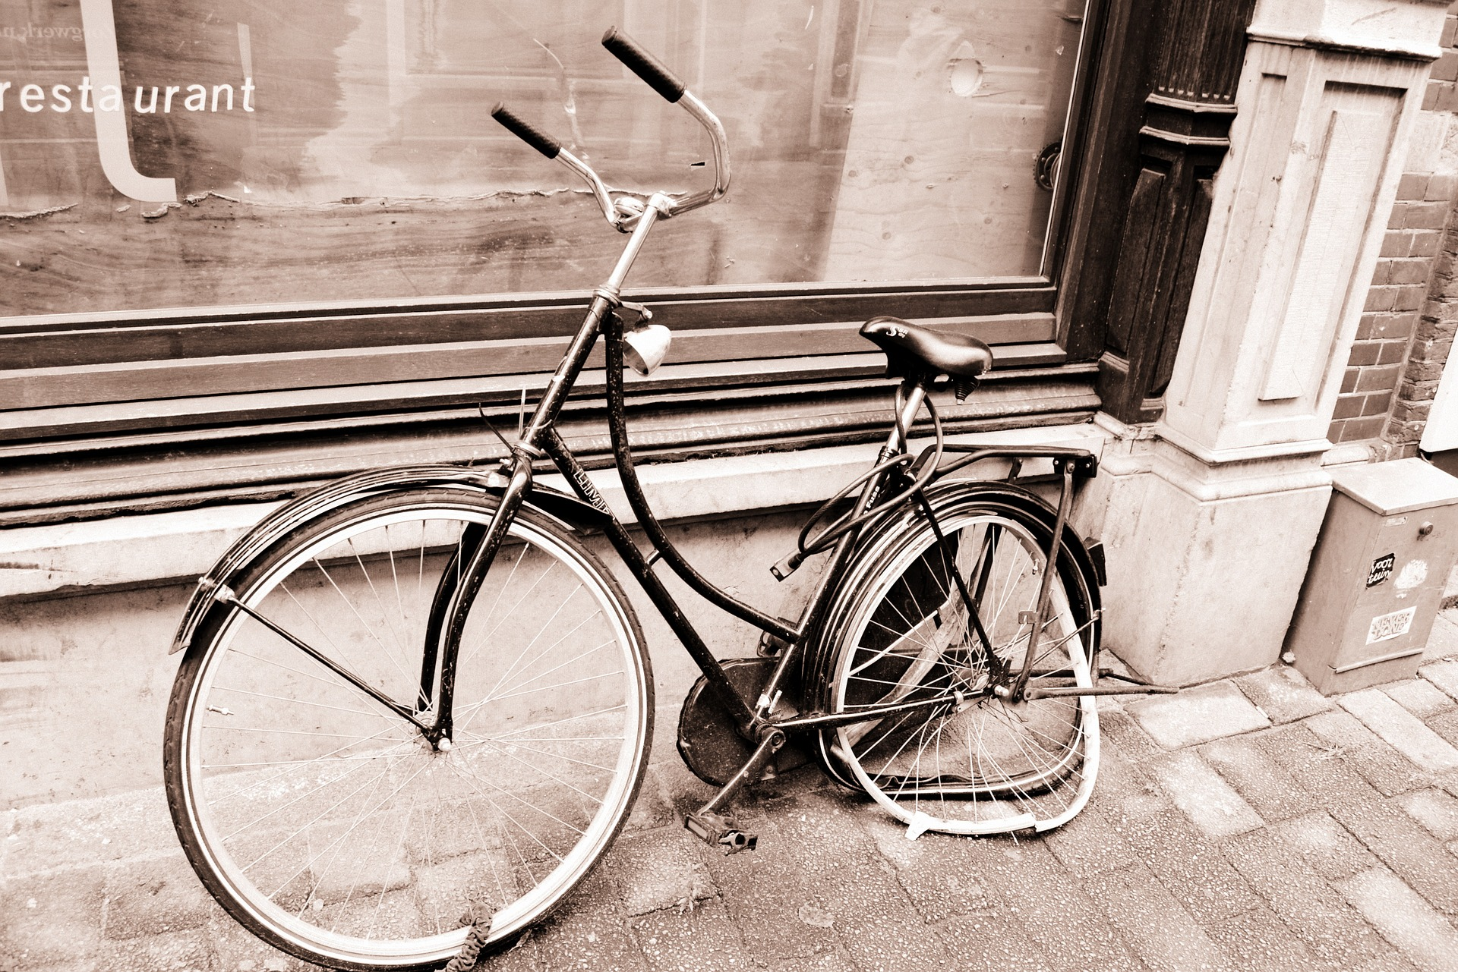
REBECCA IS FINE BUT THE BIKE IS BROKEN.

Slide 5
REBECCA IS LUCKY. SHE HAS OUR SUPER-CRISPY LIABILITY INSURANCE.
☺

Slide 6
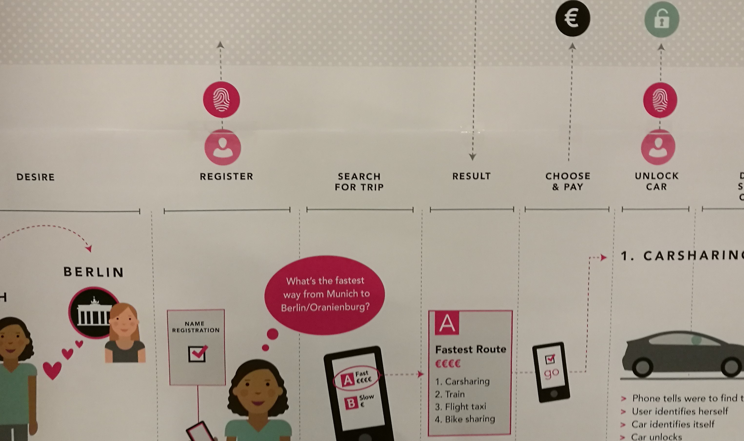


BEFORE STARTING HER JOURNEY
REBECCA GETS AN INSURANCE FOR THE TRIP
Blockchain
Only certified Insurers
Can add entries
0xabc123 is insured.
Max. coverage: 3000€.
r
REBECCA
€
INSURANCE
COMPANY
0xabc123

Slide 7
BEFORE STARTING HER JOURNEY
REBECCA RENTS A BIKE
BIKE
SHARER
Is 0xabc123 insured?
0xabc123 is insured.
Max. 3000€.
€
0xabc123
Smart Contract
Bike Sharer Insurance Company
(max. coverage 3000€)
REBECCA

Slide 8

AFTER THE CRASH
SMART CONTRACT IS TRIGGERED WITHOUT ANY INVOLVEMENT OF REBECCA
?
Possible triggers
BIKE
SHARER
Payout
INSURANCE
COMPANY
€

Slide 9
TECH

